Slide 1

Osteoporosis Classification using SVM
AMUL ASHOK KADAM
DATE : 20th July 2024

Slide 2
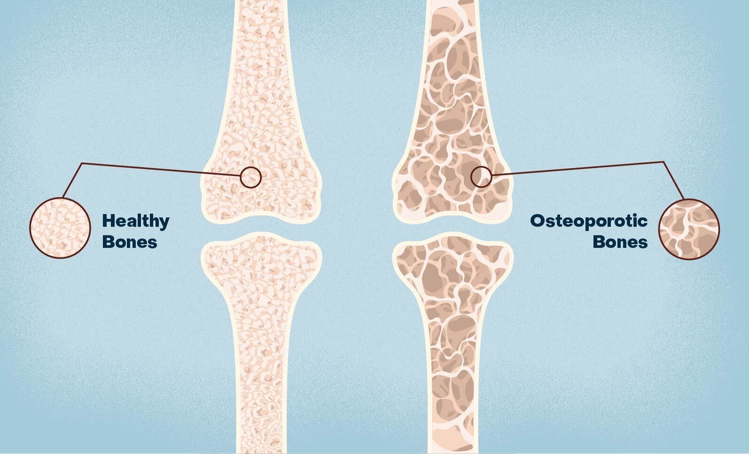
Osteoporosis
Osteo represents bones
Porosis represents weakness
Osteoporosis is a bone disease that develops when bone mineral density and bone mass decreases, or when the structure and strength of bone changes.
Osteoporosis is fragility (the quality of being easily broken or damaged) of bones.

Slide 3
Goal to make this project
Early Detection of Osteoporosis
Identify High-Risk Individuals: Develop a model that can accurately predict individuals at high risk of developing osteoporosis, enabling early intervention and prevention strategies.
Prevent Fractures: By predicting the likelihood of osteoporosis, the project aims to reduce the incidence of fractures, which are common and serious complications of the disease.
Personalized Treatment Plans
Tailored Interventions: Use predictive insights to develop personalized treatment plans based on an individual's risk factors and likelihood of developing osteoporosis.
Monitoring Progress: Enable continuous monitoring of bone health, allowing for timely adjustments in treatment strategies.

Slide 4
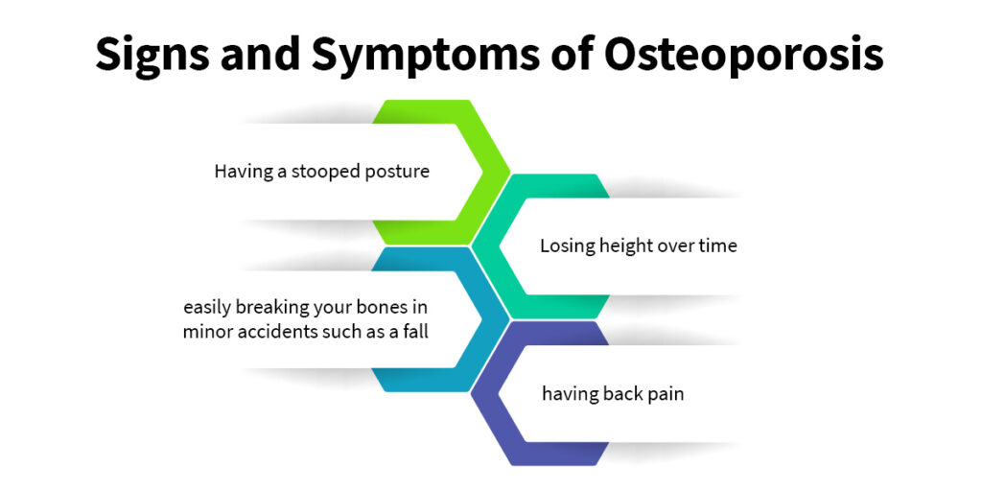
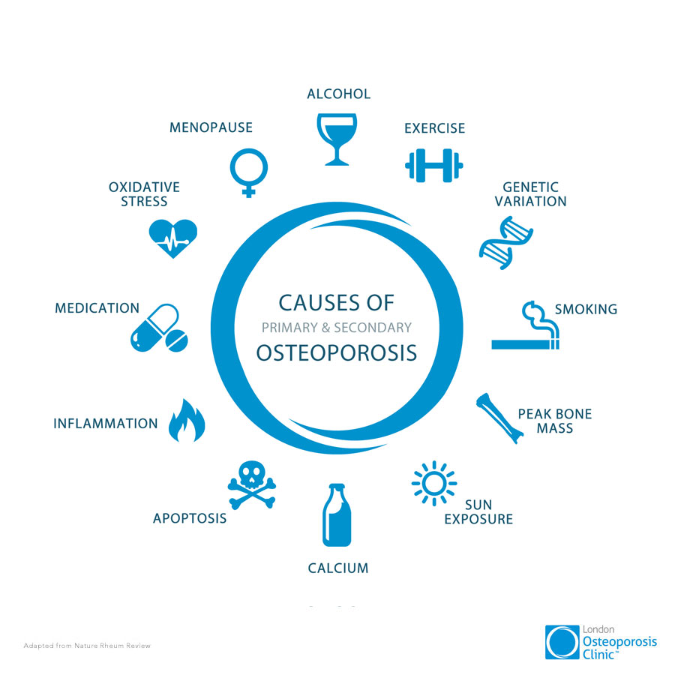

Slide 5
Preventions
Diet: Ensure adequate intake of calcium and vitamin D.
Exercise: Engage in regular weight-bearing and muscle-strengthening exercises.
Medical Check-Ups: Regular bone density tests and discussions with healthcare providers about bone health.
Medications: In some cases, medications may be prescribed to help strengthen bones and reduce the risk of fractures.
Do not Smoke
Do not consume alcohol

Slide 6
Why SVM?
Effective in High Dimensions: SVMs are particularly powerful in high-dimensional spaces and when the number of dimensions exceeds the number of samples.
Robust to Overfitting: With the appropriate kernel and regularization, SVMs can effectively manage overfitting, especially in high-dimensional spaces.
Kernel Trick: SVMs can model complex decision boundaries by using different kernel functions (e.g., linear, polynomial, radial basis function).

Slide 7
What is Support Vector Machine
Support Vector Machine (SVM) is a powerful machine learning algorithm used for linear or nonlinear classification, regression, and even outlier detection tasks.
The main goal of SVM is to find a hyperplane that best separates different classes in the feature space. For classification, this means finding a hyperplane that maximizes the margin between the classes.
Hyperplane: In a 2D space, this is a line that divides the space into two regions. In higher dimensions, it becomes a plane or hyperplane.
Margin: The distance between the hyperplane and the nearest data points from each class. SVM aims to maximize this margin to ensure better generalization.

Slide 8
Hyperparameters
C: Regularization parameter, controlling the trade-off between maximizing the margin and minimizing classification error.
Small value of C means large margin.
Large value of C means small margin.
kernel: Specifies the type of kernel function to use (e.g., 'linear,' 'rbf,' 'poly').
gamma: Kernel coefficient for 'rbf' and 'poly' kernels.
Small value of gamma means underfitting if the model is too simple to capture the underlying patterns.
Large value of gamma means overfitting.

Slide 9
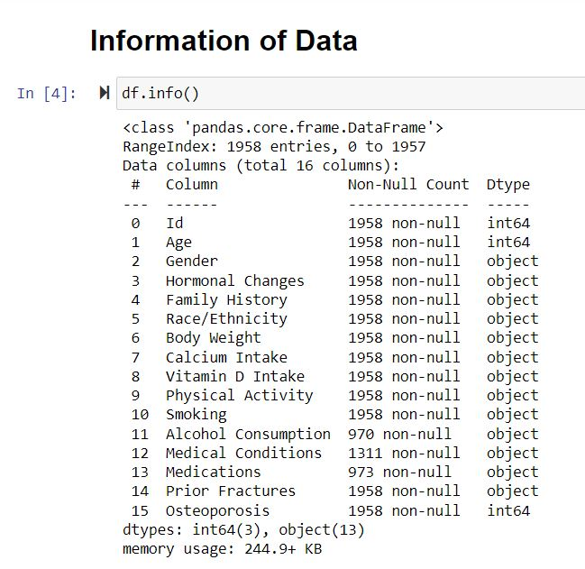
Data Collection
Website : https://www.kaggle.com/datasets/amitvkulkarni/lifestyle-factors-influencing-osteoporosis

Slide 10
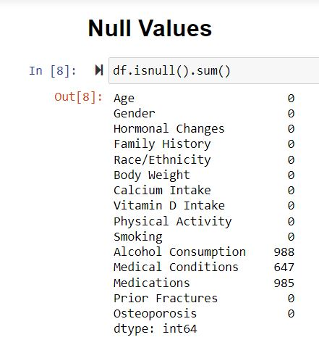
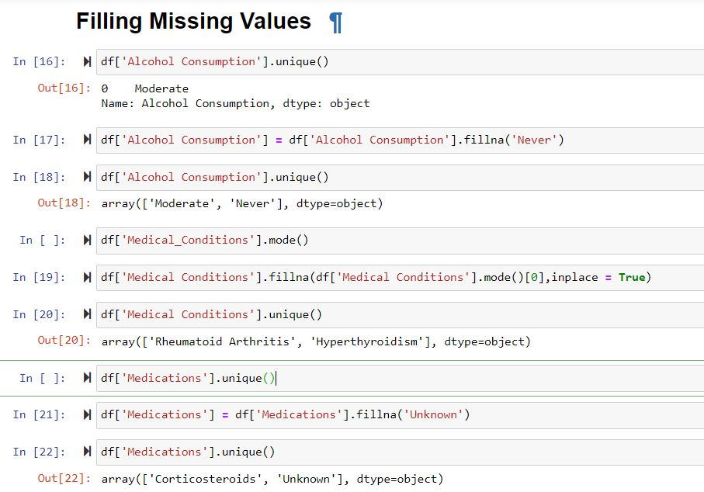
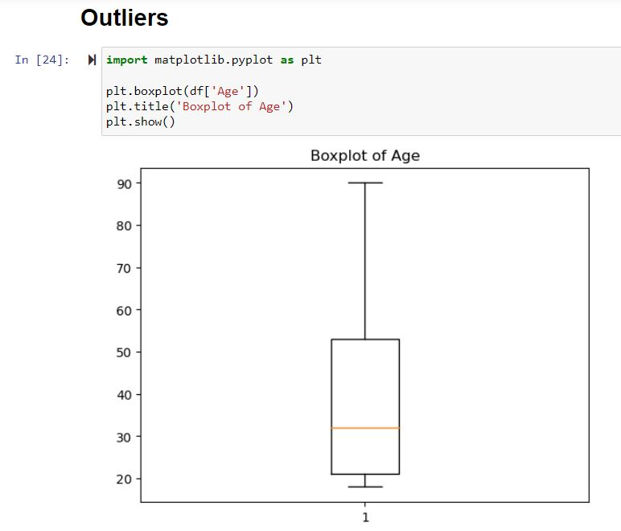
Data Preprocessing

Slide 11
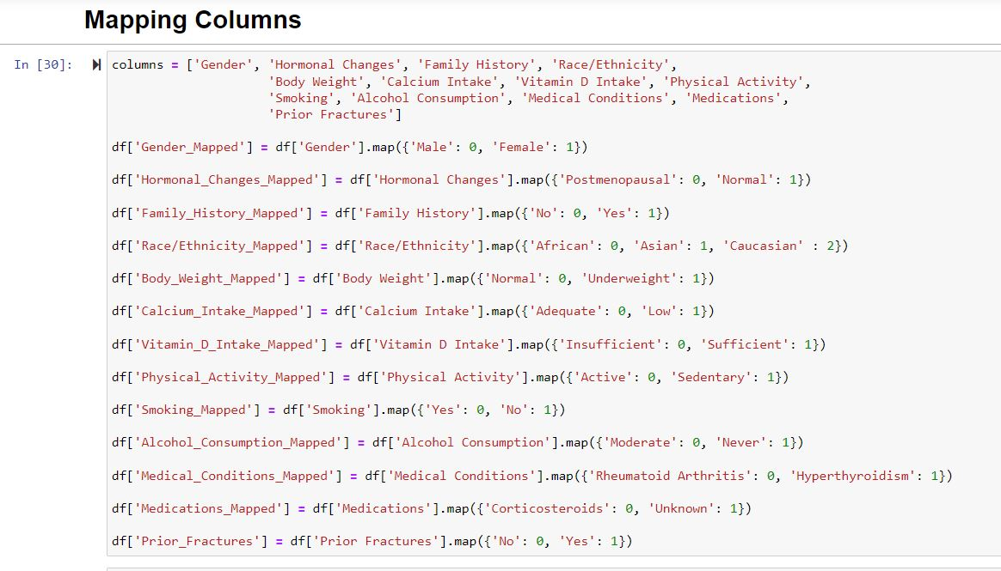

Slide 12
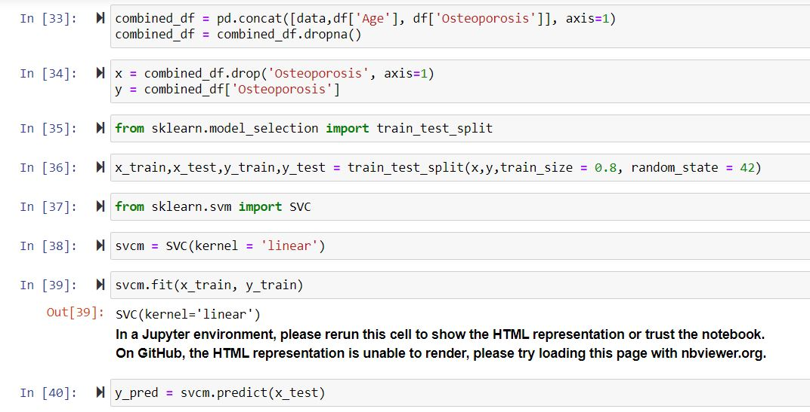
Model Development
.

Slide 13
Performance Measure and Evaluation Metrics
Accuracy
Precision : The quality of positive prediction made by the model
Recall : The rate of true positive
F1 Score : Harmonic mean of precision and recall.
AUC-ROC : Graphical representation of the performance of a binary classification model at various classification threshold.
AUC-PRC : Represents success of prediction when the classes are very imbalanced.

Slide 14
Mean CV Score and Standard Deviation of CV Scores
Mean CV Score (Before Tuning): 0.812: This is the average performance of your model across the different folds of cross-validation. It suggests that, on average, your model has an accuracy of around 81.2% before any adjustments.
Mean CV Score (After Tuning): 0.876: After tuning, the average performance of your model improved to approximately 87.6%. This suggests that your tuning process has positively impacted the model’s overall accuracy.
Standard Deviation of CV Scores (Before Tuning): 0.037: This indicates the variability or spread of the cross-validation scores. A standard deviation of 0.037 means that the performance of your model across different folds typically varies by about 3.7% from the mean score. In general, a lower standard deviation implies that the model’s performance is more consistent across different folds, while a higher standard deviation indicates greater variability.
Standard Deviation of CV Scores (After Tuning): 0.030: The standard deviation is slightly lower compared to before tuning, indicating that the performance of the model is even more consistent across different folds. The smaller standard deviation of 0.030 shows that the model’s performance variability has decreased, implying improved stability.

Slide 15
Challenges and Limitations
Computational Complexity: For large-scale datasets, SVM’s training time and memory requirements can be substantial. This necessitates the use of efficient implementations and possibly dimensionality reduction techniques to manage computational resources effectively.
Parameter Tuning: Selecting the appropriate kernel and tuning hyperparameters (such as CCC and gamma) are essential for improving model performance. This process can be time-consuming and requires careful cross-validation to avoid overfitting.

Slide 16
Conclusion
SVM can be a robust tool for classifying osteoporosis, offering high accuracy and effective handling of high-dimensional data. However, its application requires careful consideration of computational resources, parameter tuning, and feature selection. Addressing these factors can lead to a successful implementation, enhancing diagnostic capabilities and contributing valuable insights to osteoporosis management.

Slide 17
Thank You

